Slide 1


CONNECTICUT STATE DEPARTMENT OF EDUCATION
Computer Science Standards
From Adoption to Implementation
Notes:
Computer knowledge and skills are increasingly being recognized as foundational for an educated citizenry. Therefore it is becoming increasingly more important that all students have access to high-quality computer science education.

Slide 2
A Computer Science Timeline
2014
CS Advisory Group Created
2015
Joined ECEP Alliance
MSP Grant for ECS Awarded
2016
ECEP Grant for Landscape Study Awarded
2017
Two CS Summits Held
Begin Standards Adoption Process
New Graduation Requirements
2018
Standards Adoption
Pathways to Certification
Position Statement Adopted
Pass Public Act 15-94
Notes:
Understanding the importance of computer science education, the Connecticut State Department of Education has made computer science a priority in recent years. The push to expand computer science education in Connecticut began in 2014 with the formation of a computer science advisory group. This group’s primary responsibility was to draft the computer science position statement that was adopted by the board in 2016. This document has been a driving force in the continued efforts to expand computer science education.

Slide 3
CS Position Statement
Beliefs
Computational thinking skills
Importance of equity of access
Guidelines
December 2016
Adoption
Detailed responsibilities for CSDE, districts, higher education, and community
Notes:
The position statement document outlines beliefs and guidelines about computer science education to ensure the changing needs of the workplace, technology and global economy are met. Specifically it speaks to developing computational thinking which is characterized by logically ordering and analyzing data and creating solutions using a series of ordered steps. These are fundamental skills that are necessary to become college and career ready in today’s world and therefore efforts to provide a comprehensive computer science education to ALL students must be increased. This is not something that can be accomplished in isolation. All stakeholders have a responsibility to the children in our state. It is for this reason that the position statement outlines specific responsibilities for various groups of stakeholders.
.

Slide 4
CSDE Responsibilities
Lead a statewide effort to increase the quality of and expand access to computer science education at the elementary, middle and high school levels.
Develop a K-12 computer science framework.
Encourage appropriate professional development opportunities for computer science educators.
Develop relationships with professional computer science organizations, higher education institutions and business and industry to provide professional development programs, honor excellence in computer science education, and promote high-quality computer science instruction for all students.
Enable computer science courses to count toward a student’s core graduation requirements.
Notes:
Within the position statement, specific responsibilities of the CSDE were cited. The work at the agency has and continues to address these responsibilities. Specifically, computer science standards were adopted in June, 2018, opportunities for professional learning in the area of computer science is disseminated via listservs out of the Academic Office, and the agency engages collaboratively with computer science professionals both within Connecticut and nationally.

Slide 5
School District Responsibilities
Ensure that computer science is made accessible to all students, especially traditionally under-represented groups.
Ensure instructional time for computer science education for all learners.
Increase the number of students who take computer science courses at the high school level.
Offer a continuum of courses that will allow interested students to study facets of computer science in more depth and prepare them for entry into the work force or college.
Notes:
We can’t do this work alone. School districts are our partners in ensuring that all students in Connecticut receive a high-quality computer science education. This can be accomplished by allocating instructional time to computer science and offering a continuum of computer science experiences from elementary school to high school.

Slide 6
K-12 Computer Science Framework
October 2016
Notes:
Computer science has not just been a focus at the state level. Computer science has gained national attention in recent years and in 2016, The Association for Computing Machinery, Code.org, the Computer Science Teachers Association, the Cyber Innovation Center, and the National Math and Science Initiative collaborated with states, districts, and the computer science education community to develop conceptual guidelines for computer science education.

Slide 7
Background of the Framework
27 writers
14 states represented
4 districts represented
25 advisors from the CS education community
Industry: Google, Amazon, Microsoft, Apple...
Organizations: College Board, PLTW, Achieve, CCSSO, NGA, ISTE, NAF...
Notes:
The K-12 Computer Science Framework was not an independent effort. The final framework was the result of input from a variety of stakeholders. The 27 writers represented a range of states, districts, industry partners and other interested organizations.

Slide 8

Vision
A framework that will empower students to…
be informed citizens who can critically engage in CS-related discussions
develop as learners, users, and creators of CS knowledge and artifacts
better understand the role of computing in the world around them
learn, perform, and express themselves in other subjects and interests
Notes:
The framework was developed with a vision for computer science education. Through a strong foundation in computer science, students will not only be prepared to live in the digital world, they will have the capacity to create future technologies. They will understand the impact that computing has on not only in specific field, but on society as a whole.

Slide 9
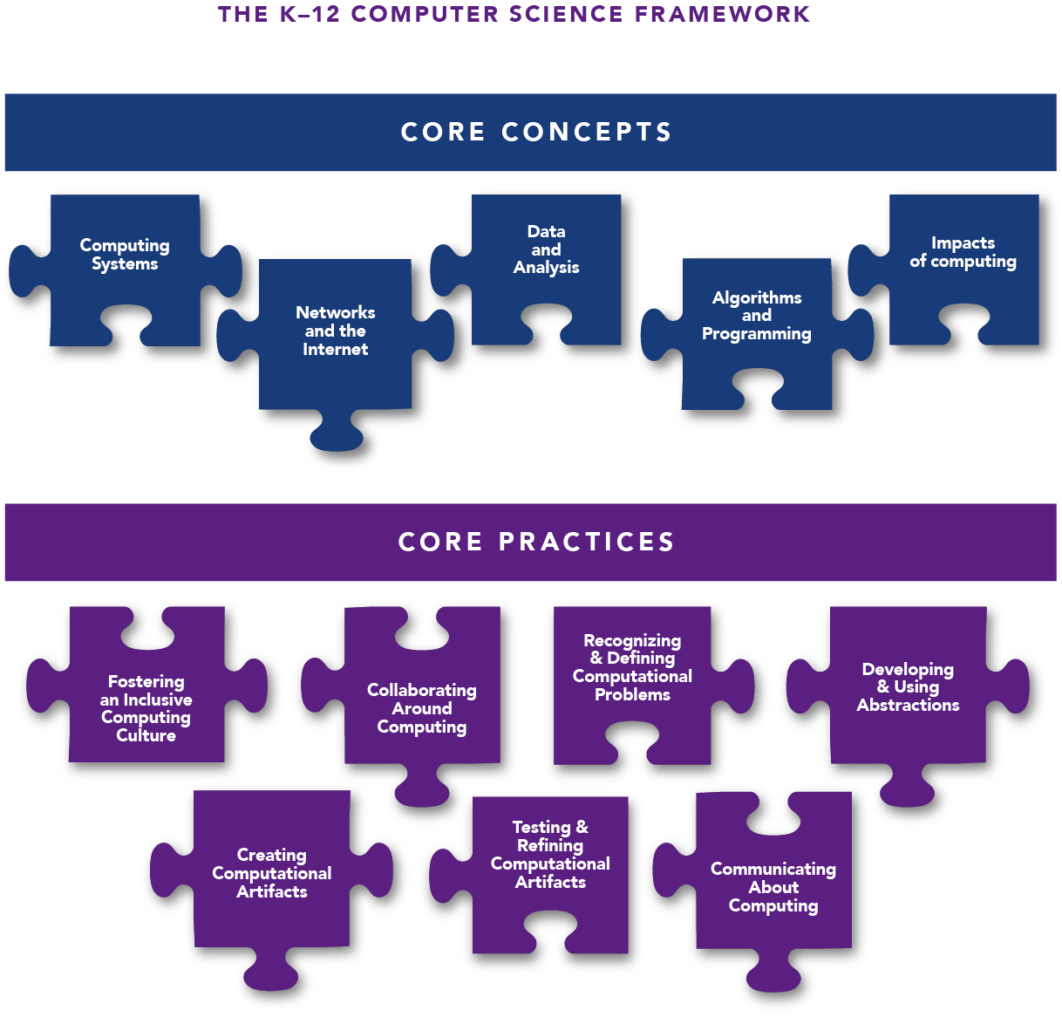
Core Concepts and Practices
Multiple concepts and practices fit together to create meaningful experience in computer science.
16
Notes:
The framework articulates 5 core concepts related to computer science. While the order of the 5 concept areas do not prescribe an instructional order, they are arranged to illustrate the movement from the physical reality of computer science to the societal impact. Each successive layer gets more abstract. In addition to the core concepts, 7 practices are identified. The concepts and practices fit together to create a meaningful computer science experience for students.

Slide 10

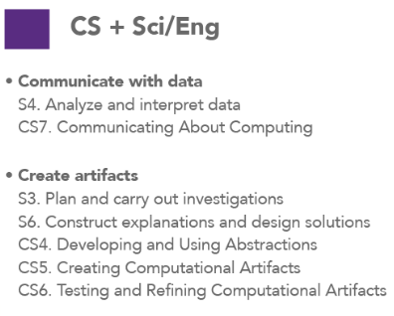
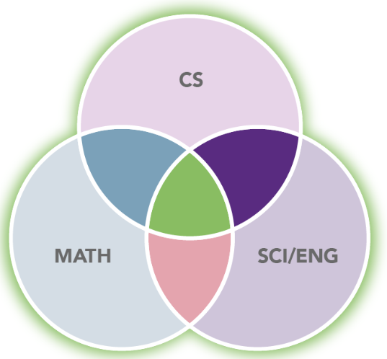
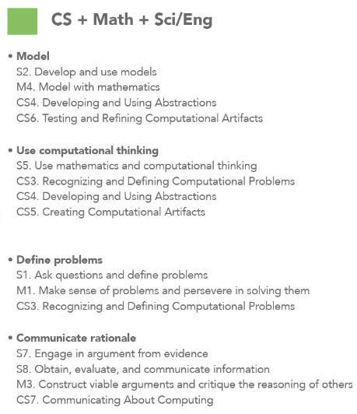
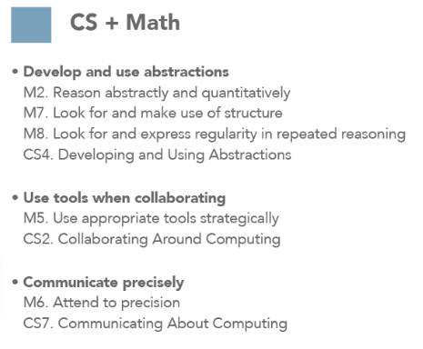
Notes:
Although computer science is an independent discipline, there is overlap particularly in the areas of science and engineering and math. This graphic highlights the connections with computer science and the math practices found in the Connecticut Core Standards, computer science and the practices noted in the Next Generation Science Standards and ultimately how all three relate to each other.

Slide 11
The Framework is not standards
Concepts and practices are not as prescriptive or measurable as performance standards.
They do not address individual grade level granularity (instead they address grade bands).
There are much fewer statements in the framework than in a standards document. The focus of the framework is a minimum set of concepts and practices that form a baseline literacy in CS.
To create standards, a state would combine concepts and practices into measurable performance standards and enact as policy statements.
16
Notes:
There is a distinct difference between a framework and standards. In very simple terms a framework is a general guideline that provides a basic structure while standards are more specific and able to be measured. Therefore, the framework was the foundation for the creation of standards that are the basis for instruction related to computer science.

Slide 12
Framework to Standards
CSTA Computer Science Standards 2017
Notes:
Following the release of the K-12 Computer Science Framework, the Computer Science Teachers Association revised their computer science standards.

Slide 13
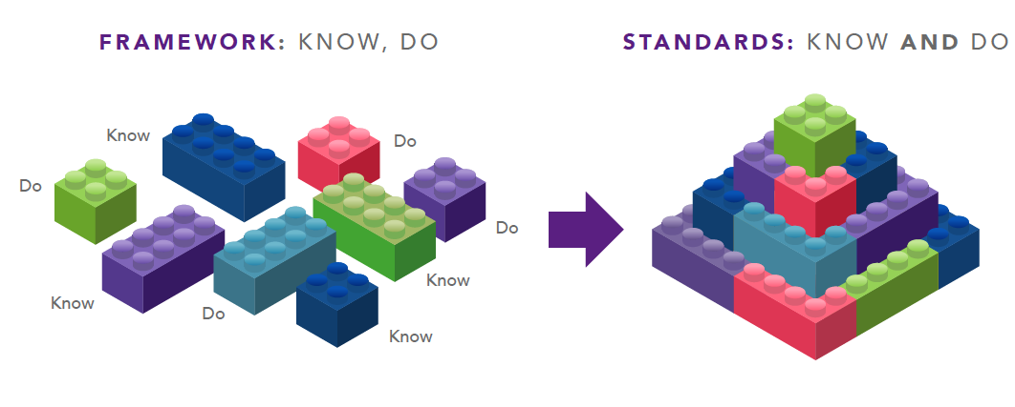
Framework to standards
Notes:
The framework consists of discrete statements of what students know or do. Standards are built from the framework statements and consist of what students know and do. The standards developed by the Computer Science Teachers Association align to the framework and define measurable learning from kindergarten to grade 12. Schools and districts are responsible for developing the curriculum which is how the standards will be taught.

Slide 14
Concepts, Practices, and Standards
Concepts
Practices
Standards
Concepts are what a student should UNDERSTAND or know.
Baseline level of competency in CS exiting 2nd, 5th, 8th, and 12th grade.
General, high-level, core content expectations.
Address high-level transferable knowledge and CS as a literacy for all students
A practice is a WAY of doing things: a computer scientist decomposes problems as part of doing design.
Students can’t fully understand the core concepts without engaging in these practices.
Similarly, students can’t develop or demonstrate growth in these practices without the context of core concepts.
A learning progression for practices describes how to develop these practices in the major areas of CS.
Standards reflect what a student should know and be able to do.
Describe student performance expectations based on combination of concepts and practices.
Grade-by-grade granularity
Specific, measurable, describe explicit level of rigor
Notes:
The Framework consists of concepts and practices. The concepts are high-level expectations of what students should understand the practices describe the way that this should be done. Together, defining what students should know and be able to do results in standards that are independent, specific and measurable.

Slide 15
CSTA K-12 Computer Science Standards
Revised in 2017
The Framework was considered as one primary input for the standards development process
The standards delineate a core set of learning objectives designed to provide the foundation for a complete computer science curriculum and its implementation at the K–12 level
The standards are based on a progression of learning
Adopted by the Connecticut State Board of Education in June, 2018
Notes:
The revised standards released by the Computer Science Teachers Association in 2017 align to the framework statements, are based on a progression of learning, and provide a foundation for the study of computer science. On June 6, 2018, the Connecticut State Board of Education adopted these standards as the basis for computer science education in the state. Districts can now use these adopted standards to write computer science curriculum.

Slide 16
A Closer Look at the Standards
Detailed measurable student performance expectations
5 Concepts, 16 Sub concepts, and 7 Practices
5 levels of standards
  Level 1A - Grades K-2 (Ages 5 – 7)
  Level 1B - Grades 3-5 (Ages 8 – 11)
  Level 2 - Grades 6 – 8 (Ages 11 – 14)
  Level 3A - Grades 9 – 10 (Ages 14 – 16)
  Level 3B - Grades 11 – 12 (Ages 16 – 18) – advanced study of CS
ALL Students
Notes:
The CSTA Computer Science Standards identify measurable student performance expectations by grade band. The expectations contained in the K-2, 3-5, 6-8 and 9-10 grade bands are intended for all students to ensure a comprehensive computer science education. The 11-12 grade band is for students who are looking to pursue further study in computer science or related fields. Within the standards there are the 7 practices and 5 concepts that were in the framework and there are 16 identified sub-concepts.

Slide 17
Recap
Framework
  High level, conceptual guide of concepts and practices
  ex: NRC K-12 Science Framework, K-12 CS Framework
Standards
  Specific, Measurable, Performance expectations
  ex: NGSS, Common Core
Curriculum
  What and how to teach a topic
  ex: lesson plans
Notes:
To recap what has been discussed so far, the framework is a high level, conceptual guide. It should not be confused with standards. Standards are specific measurable performance expectation and should not be confused with curriculum. Curriculum is what and how to teach the standards. Curriculum that addresses the standards that have been adopted by the state is determined at the local level.

Slide 18
Standards to Implementation
Notes:
Since the standards are identified by grade band as opposed to a specific grade, districts have a great deal of flexibility in how they choose to implement the standards in their schools.

Slide 19
Connecticut Computer Science Implementation Guidelines
Provides a background
Explains computer science and computational thinking
Addresses equity in computer science
Details the practices and organization of the standards
Suggests models of implementation
Lists resources to support implementation
Notes:
In order to assist districts in determining an implementation plan, the Connecticut State Board of Education adopted the Connecticut Computer Science Implementation Guidelines in partnership with the adoption of the standards. This document was created by a diverse group of stakeholders. It not only provides some background and information relative to the discipline of computer science, it also provides a detailed description of the practices and standards organization as well as various models and resources to support implementation.

Slide 20
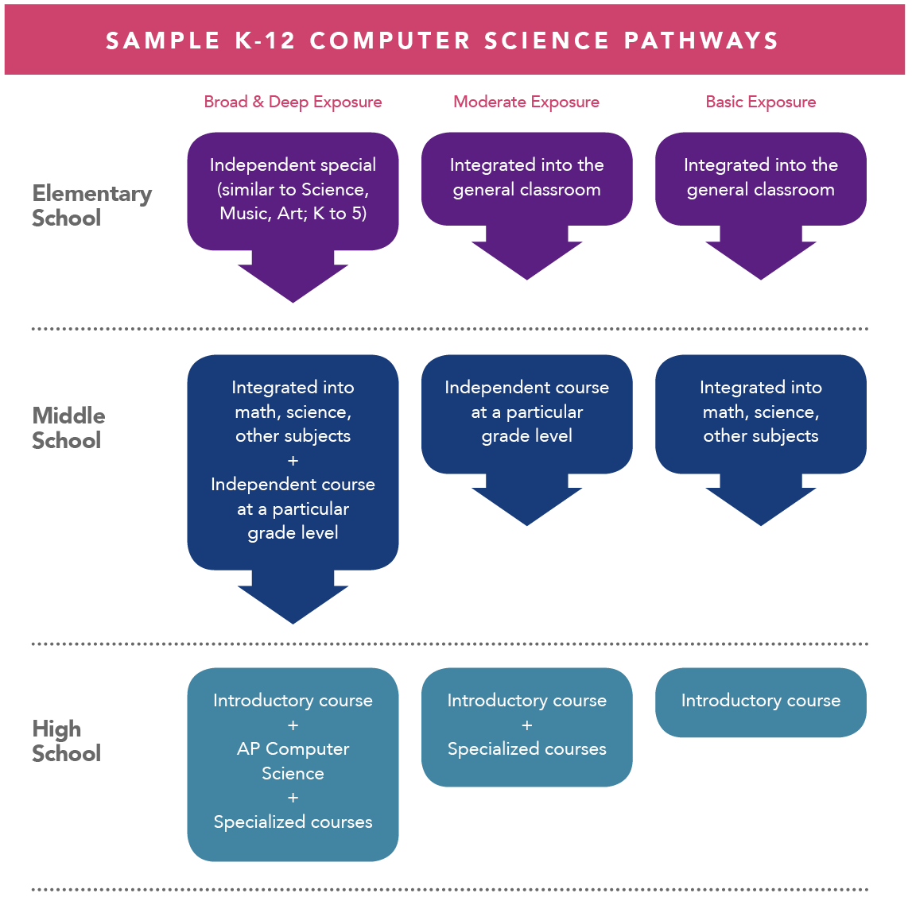
Implementation Guidance
There are multiple pathways states, districts, and schools can take to K–12 Computer Science for all students.
Notes:
There are a variety of pathways that districts can use when implementing computer science and it depends in large part by the level of exposure to computer science the district is striving for. Districts that are newly implementing a computer science curriculum may first have basic exposure to the content while they develop teacher capacity and a long term computer science plan. Others may choose to have a deep exposure to computer science and others may fall somewhere in between. Regardless of the path that is chosen by the district, computer science should be for all students.

Slide 21
Example – Elementary and Middle School Implementation Model
Integrated into Curriculum
Independent Special
Integrate CS into a particular subject area on a weekly or biweekly basis
Utilize CS resources aligned to CT Core Standards and Next Generation Science Standards
Provide a weekly “specials”/ “unified arts” course designed to specifically teach the CS standards
Additional Recommendations
20 hours of yearly CS instruction
Use a combination of “unplugged” and “plugged” lessons
Notes:
Finding time for computer science in an already busy school day can be a challenge. At the elementary and middle school level, time for computer science can be found by creating a course that specifically teachers computer science during a set time in the day or week similar to art or music. Another option at the elementary and secondary level is to embed computer science into the already existing curriculums. There are a variety of resources for computer science that align to the Connecticut Core Standards as well as the Next Generation Science Standards. At these levels, 20 hours of yearly instruction is recommended. Lastly, computer science instruction does not require any specific hardware or software. There are lessons that are both “plugged” meaning utilizing technology and “unplugged” which do not that still address the standards and teach the fundamental concepts of computer science.

Slide 22
Example – High School Implementation Model
High School Recommendations
Encourage one credit or it’s equivalent for all high school students
Create a pathway of courses from introductory to AP Courses
Count CS courses as a credit for the nine credits in science, technology, engineering, and mathematics required for graduation beginning in 2023
Notes:
At the high school level, computer science education is most easily achieved by offering stand alone courses. Establishing a pathway of courses instead of just a singular computer science course is recommended as this will be the best way to prepare and encourage students to take AP level computer science courses. Based upon the new graduation requirements that begin with the class of 2023, computer science courses could count towards the nine credits in science, technology, engineering and math depending upon local policy.

Slide 23
Computer Science in CT Summary
Notes:
Computer science has come a long way in a relatively short amount of time in Connecticut.

Slide 24
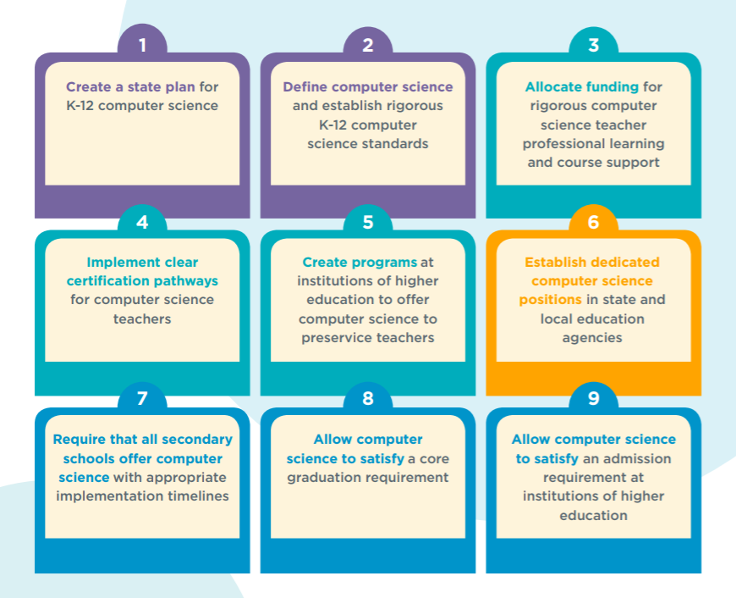



Assessing Progress
Notes:
Code.org collects data relative to 9 different state criteria. When we look at CT we have completed 3 of the 9 including having a dedicated computer science position at the state department, adopting standards, and allowing computer science to count as a core graduation requirement. Three additional items are well underway. A basic state plan has been developed, but more time needs to be spent on determining timelines and indicators of success. An internal workgroup has submitted recommendations and further work in this area is on the horizon. Finally, some of our institutes of higher education are beginning to take a close look at computer science in terms of teacher prep and professional learning. Given the local nature of our educational structure, we may never complete all 9, but in a short time, we have made some headway.

Slide 25
For Additional Information
Visit the Connecticut State Department of Education Computer Science webpage: https://portal.ct.gov/SDE/Computer-Science/Computer-Science
Join the Computer Science listserv: email Jennifer.Michalek@ct.gov
Visit the Connecticut Computer Science Teachers Association website: http://www.ctcsta.org/
Notes:
Additional information about computer science is available on the computer science page of the Connecticut State Department of Education website. In addition, a listserv has been created to keep the field up to date on opportunities for teachers and students related to computer science. Finally, there is an active chapter of the Computer Science Teachers Association in Connecticut and you are encouraged to visit their website for a variety of useful implementation.

Slide 26
Thank You
Jennifer Michalek
Education Consultant
Jennifer.Michalek@ct.gov
860-713-6557
Notes:
Thank you for your time an if you have any additional questions, please feel free to contact me directly by email or phone.

